Slide 1
Chapter 1
Signal & Signal Processing
Why DSP？

Slide 2
§1 Signals and Signal Processing
Signals—generated by natural or technical means .
Signals—carry information.
Signals—the mathematical representation
Functions of one or more independent variables.

Slide 3
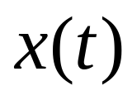
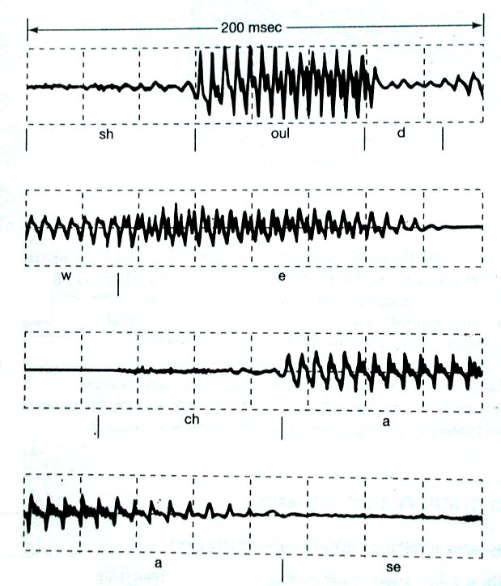
§1 Signals and Signal Processing
1-D signal A speech A Speech Signal

Slide 4


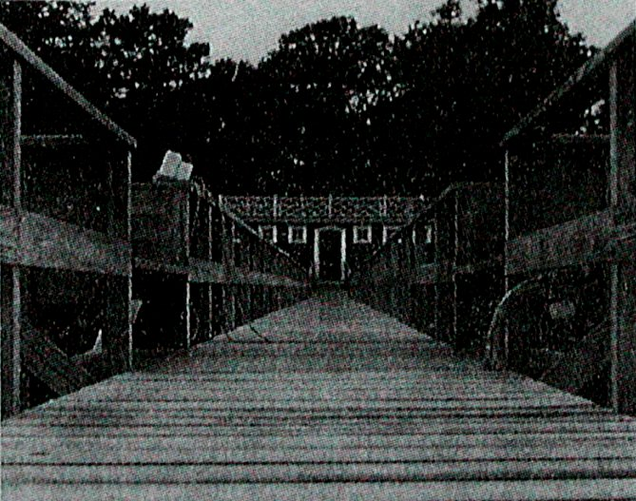
§1 Signals and Signal Processing
2-D signal A image
Disccusion:
Represent a video as a function

Slide 5
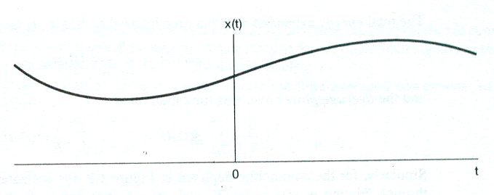
§1 Signals and Signal Processing
§1.1 Characterization and Classification of Signals
Continous-time signal—continuous independent variables .

Slide 6
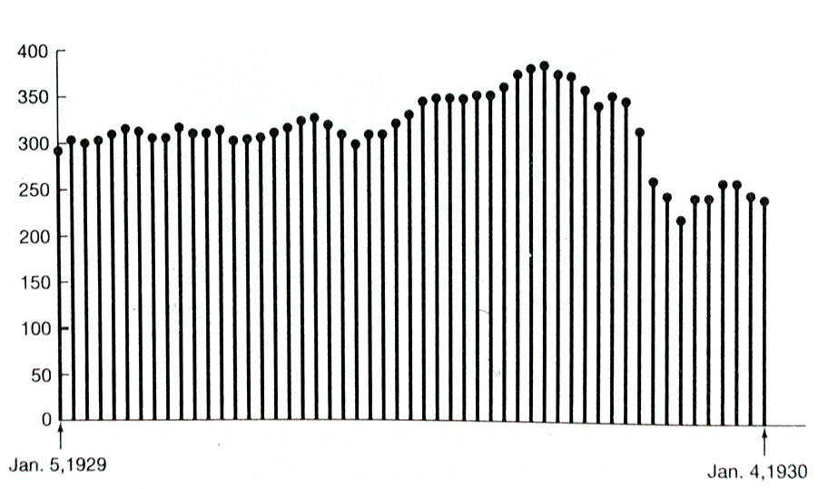
§1 Signals and Signal Processing
Discrete-time signal—discrete independent variables.

Slide 7
§1 Signals and Signal Processing
Analog signals— Continous-time signal
with continuous amplitude.
(values of real number)
Digital signals— Discrete-time signal
with Discrete-valued amplitudes.
(quantized the values)

Slide 8
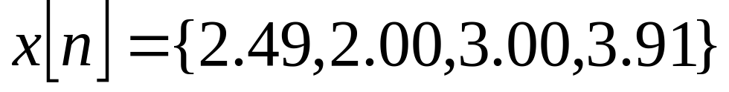
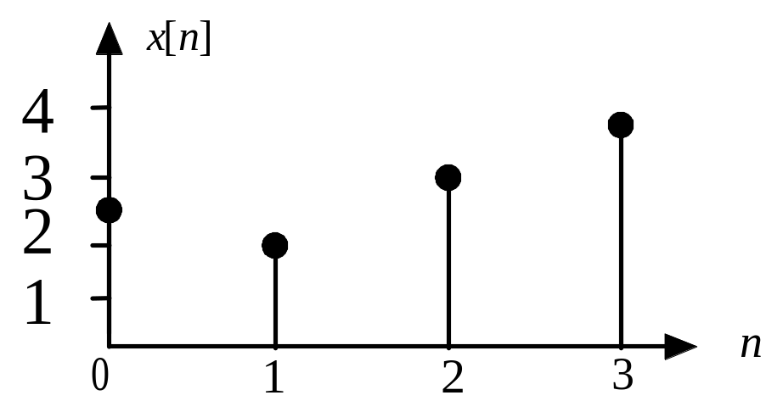
§1 Signals and Signal Processing
the real values of amplitudes
How can we quantize the values of signal?

Slide 9
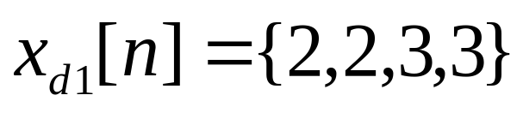
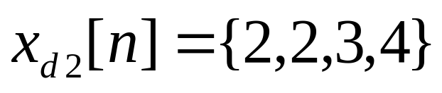
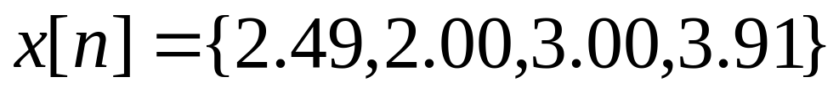
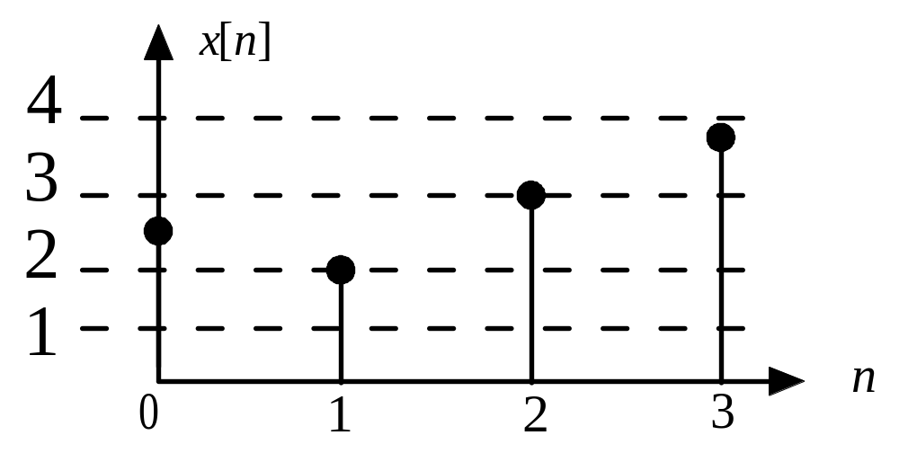
§1 Signals and Signal Processing
If the quantization step we chosed is 1,we get
Digits
by truncation
by rounding
Digits

Slide 10
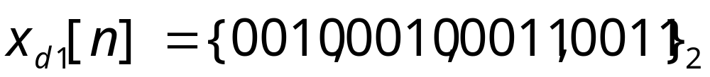
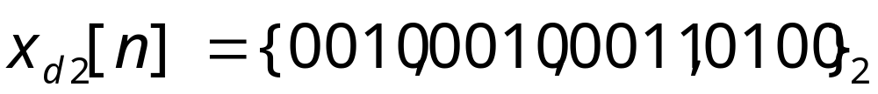
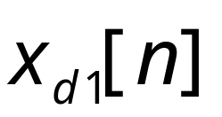

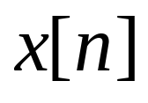
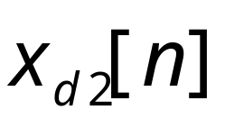
§1 Signals and Signal Processing
The representation of digits in binary form
by truncation
by rounding
The values of
The values of
The Finite Wordlength Effects

Slide 11
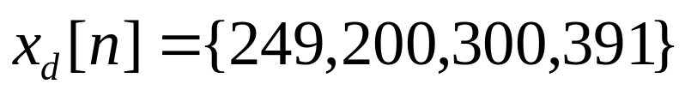
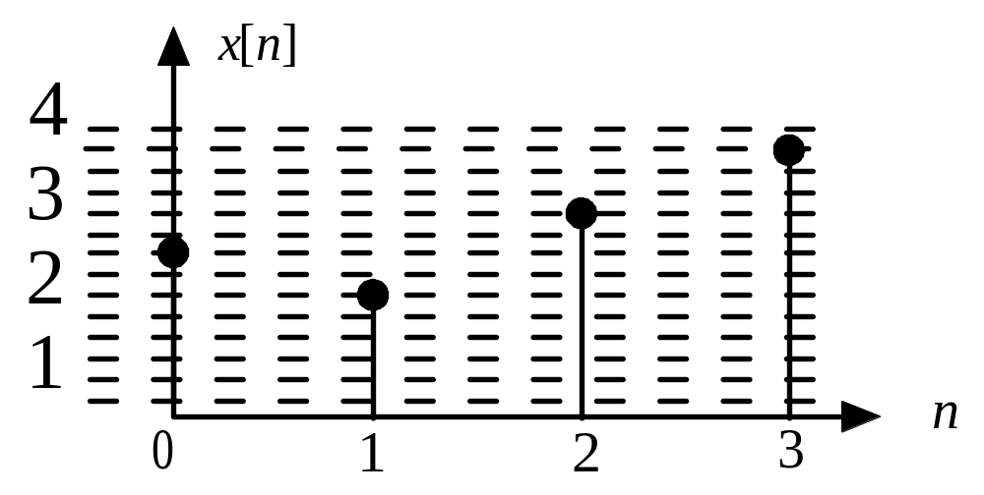
§1 Signals and Signal Processing
If the quantization step we chosed is 0.01,we get
Digits

Slide 12
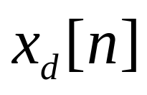
§1 Signals and Signal Processing
The values of
A digital signal could be considered that it’s the same as
a discrete-time signal.
(with the Infinite Wordlength)

Slide 13
§1 Signals and Signal Processing
Example. Communication
input
signal
transmitted
signal
Received
signal
output
signal
Transmmiter
Receiver
intermediate
Speech,Text,
Audio,
Video
Speech,Text,
Audio,
Video
Voltage, current,
Electromagnetic
With Information

Slide 14
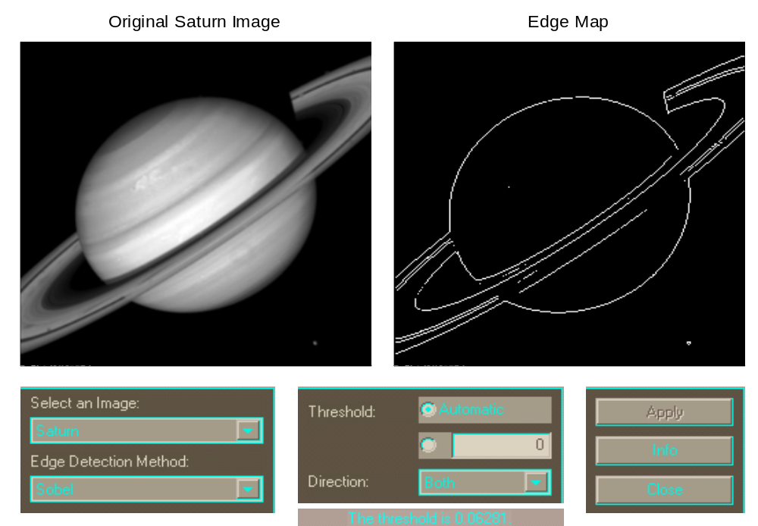
§1 Signals and Signal Processing
Example. Get the edge of a picture
Original Saturn image
Edge Map

Slide 15
§1 Signals and Signal Processing
§1.3 Digital Signal Processing
ASP----Processing signals in analog form.
Response
Exciting
Analog System
(Analog signal)
(Analog signal)
DSP----Processing signals in digital form.
It’s generally used for the digital processing of an analog signal

Slide 16
§1 Signals and Signal Processing
§1.2 Typical Signal Processing and Applications
Signal Processing—to extract useful information
—to change signals for desired purpose.
—normally work as a system.
Response
Exciting
System
(Input signal)
(Output signal)

Slide 17
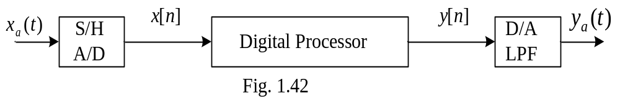
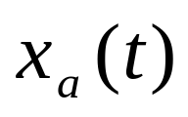
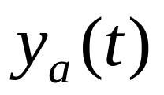
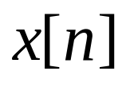
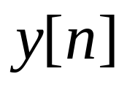
§1 Signals and Signal Processing
1.3.1 How to DSP?
Figure 1.42 Scheme for the digital processing of an analog signal
analog signals
digital signals(binary)
Digital Processor :Hardware(VLSI) and Softwares.

Slide 18


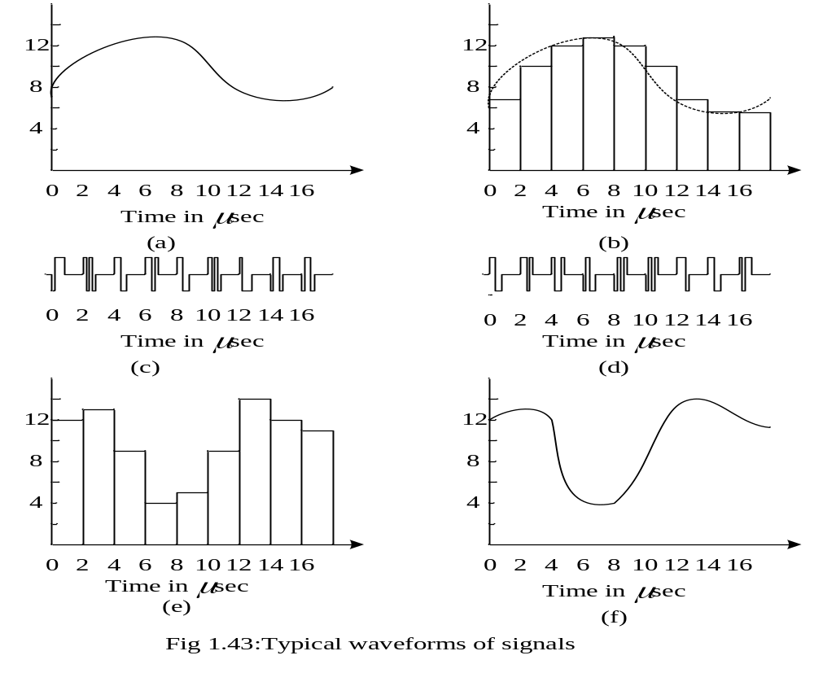


§1 Signals and Signal Processing

Slide 19
§1 Signals and Signal Processing
1.3.2 Why DSP?
（1）Programmability
Analog system：Modify hardware design.
Digital system：Modify software.
Example：Analog filter, digital filter, adaptive filter

Slide 20
§1 Signals and Signal Processing
（2）Precision
Analog system：component specification: resistors have a tolerance 5%; capacitors 20% or worse
Digital system：ADC bits, CPU word width and algorithm

Slide 21
§1 Signals and Signal Processing
（3）Stability
Analog system：the characteristics of analog system components, resistors, capacitors and operational amplifiers will change along with temperature, humidity
Digital system：will show no variation with temperature throughout their guaranteed operation range.

Slide 22
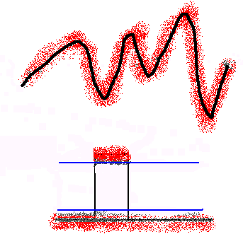
§1 Signals and Signal Processing
(4) Anti-noise

Slide 23
§1 Signals and Signal Processing
(5) Repeatability
computer A
Amplify A
Signal generator
computer B
Amplify B

Slide 24

§1 Signals and Signal Processing
（6）VLSI (Very Large Scale
Integrated circuit)

Slide 25
§1 Signals and Signal Processing
(7) Error Correcting Codes
Data retrieval and transmission systems suffer from a number of potential forms of error.
With information in a digital or binary form, we may easily build into the data stream additional “redundant” bits that are used to detect when an error has occurred.

Slide 26
§1 Signals and Signal Processing
(8) Data Transmission and Storage
The Internet, Compact Disc (CD) and Digital Video Disc (DVD) brought information based on trouble-free high-quality text, audio and video into the office and home.
The fidelity of the digital medium is greater than that of the analog one.

Slide 27
We still need analog processing
§1 Signals and Signal Processing
（1）Real-Time Processing
Analog system：Besides the delay introduced by the circuit, the processing is in real-time.
Digital system：Decided by the processor speed.

Slide 28
We still need analog processing
§1 Signals and Signal Processing
（2）Processing very high frequency signals
Analog system：may process microwave, mini-meter-wave, even light wave signals.
Digital system：By the Nyquist Rule，the processing speed is limited by the S/H, A/D and processor speed.

Slide 29
We still need analog processing
§1 Signals and Signal Processing
(3)The most signals in real would are analog.
If we want to process these analog signals with digital signal processing system, we must change them into digital form first by mixed signal processing.

Slide 30
§1 Signals and Signal Processing
1.3.3 Applications of DSP
Electrocardgraph,Seismic,Speech,DVD,
Mobile Phone,ETC.

Slide 31
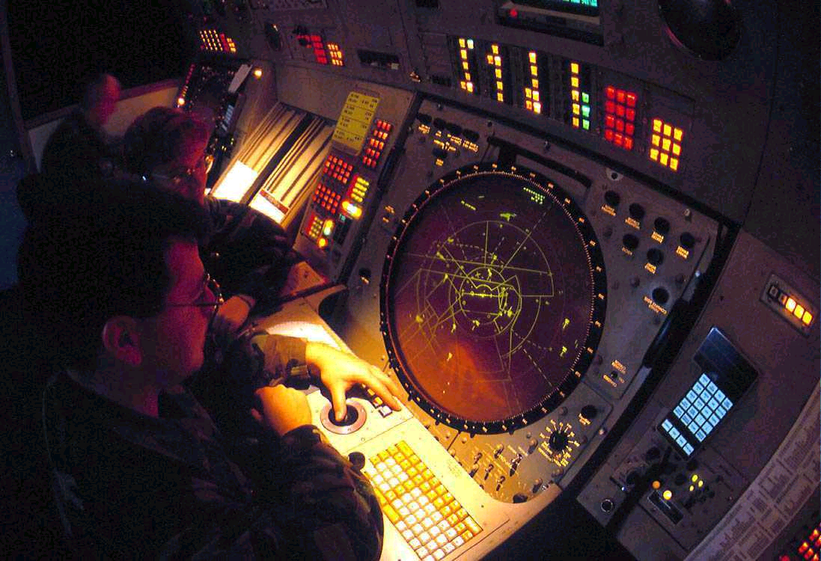
Radar/Sonar
§1 Signals and Signal Processing

Slide 32

GPS(Global Position System)
§1 Signals and Signal Processing

Slide 33

Digital Camera
§1 Signals and Signal Processing

Slide 34
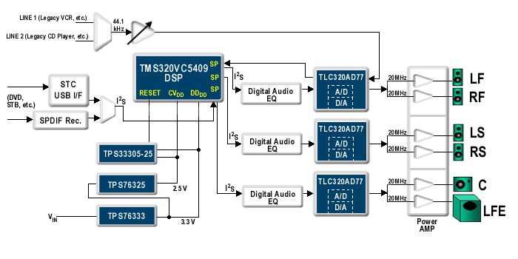
DB Digital AC-3
§1 Signals and Signal Processing

